Slide 1
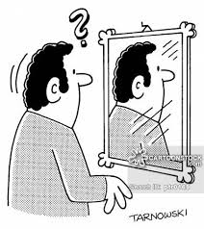
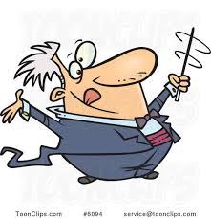

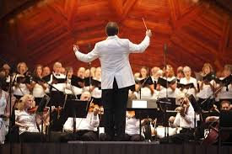
Conducting as metaphor: what they see is what you get
Workshop outline
Introduction:
  what really is our job?
  What can we show?
  Evolution of the choir’s needs from…
      first rehearsal…
      to concert
Review: a few of the basics
Conducting techniques applied to real music
  Many opportunities for YOU to conduct!
Is there a change??

Slide 2
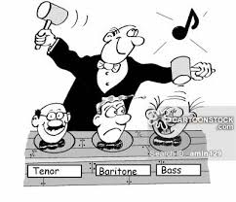
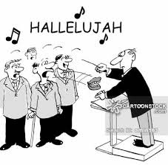
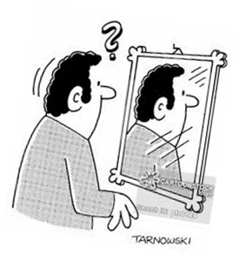
Introduction
Conducting as metaphor
  We don’t make the music…our singers do
  We use metaphor to evoke suitable responses
  If the response is not adequate…
      We try something different, or…
      We talk!
      More talk = less sing. So…
      Better gestures = more efficient rehearsal
  Everything we do/show means something
    If it is helpful, keep it
    If not, get rid of it!
Notes:
Use quarter-note ‘la’ exercise for variety of every type

Slide 3
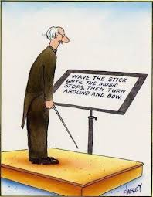
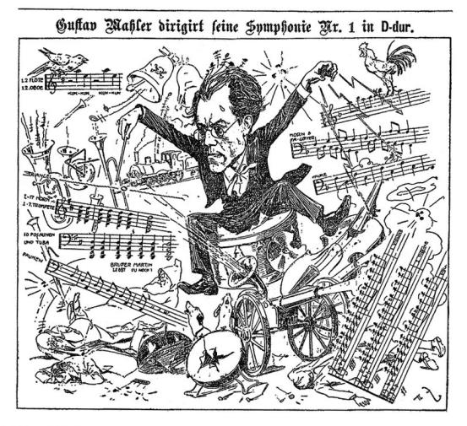
Introduction (continued)
What can/do we show?
  Beat patterns
  Starts/stops
  Fermatas
  Dynamics and changes (gradual and sudden)
  Tempo and changes (gradual and sudden)
  Articulation
  Shape of the line
  Priority of part
  Color
  Emotion
  And more

Slide 4
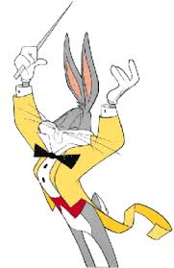
Evolution of the choir’s needs
First reading…
  Tempo
  Entrances
Performance…
  Much less directing traffic
  More shaping nuance
  More communicating drama

Slide 5
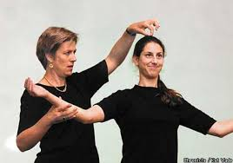
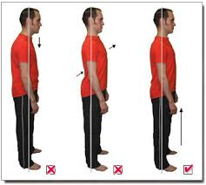
A few basics: Posture
Principle: conducting as metaphor! “What they see…”
Singer’s posture = conductor’s posture
  Tall spine
  Tail tucked in
  Shoulders back

Slide 6
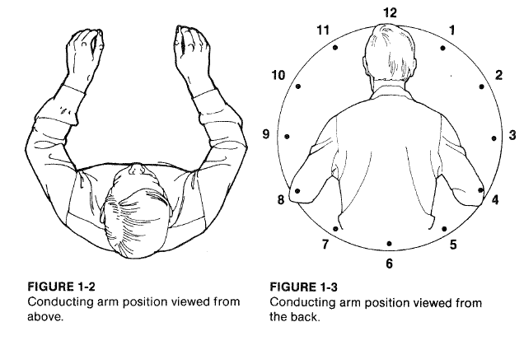
Arm and hand position
Notes:
Explore downsides of alternate positions: too high, elbows in

Slide 7
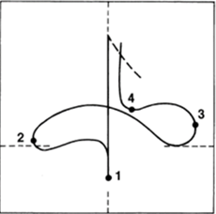
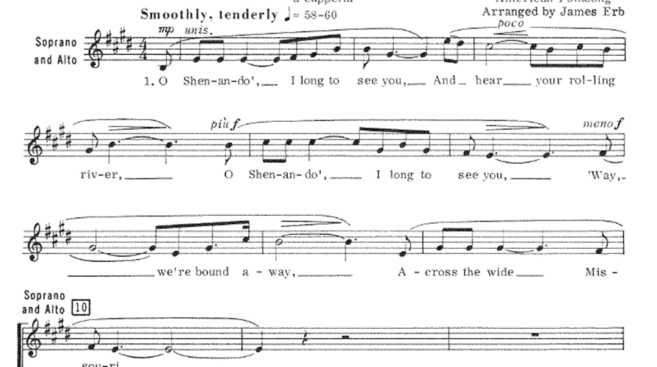
Beat patterns: four-beat pattern

Slide 8
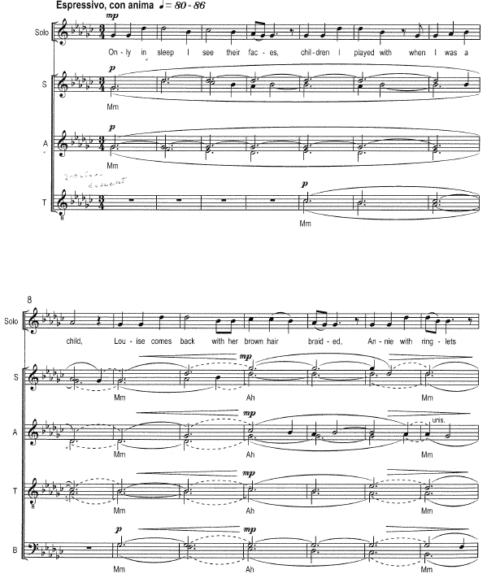
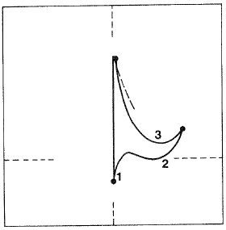
Three-beat pattern

Slide 9
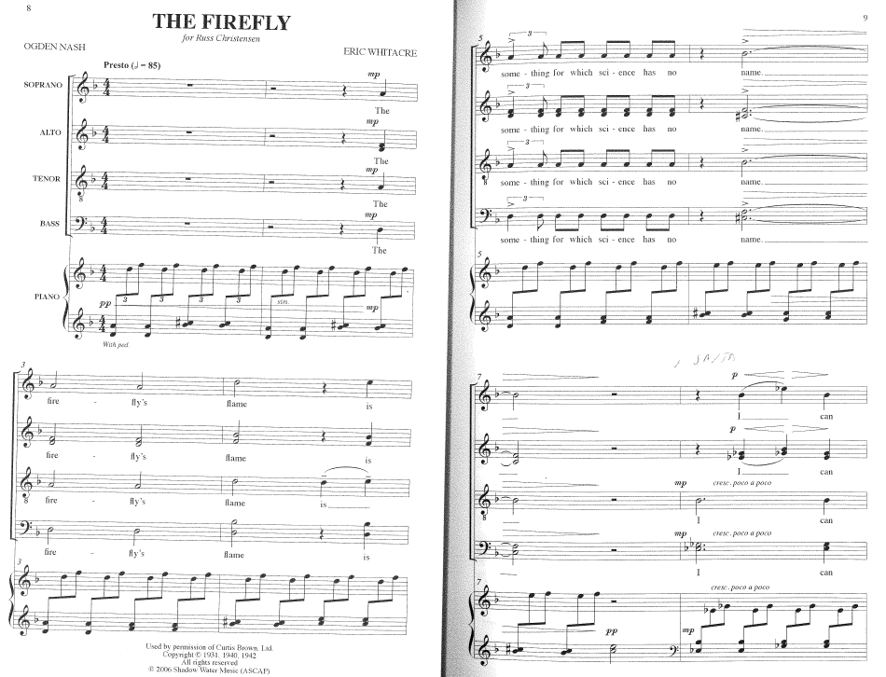
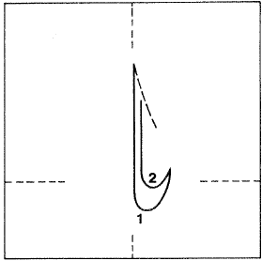
Two-beat pattern

Slide 10
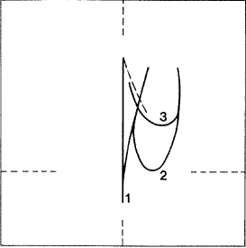
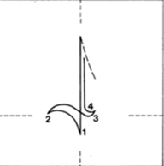
A couple pattern problems…
Large rebound
Disproportionate size beat two

Slide 11
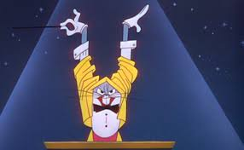

The Preparatory Beat!
What should it show???
  Tempo
  Dynamics
  Articulation
Necessary components
  Eye contact
  Complete stop before prep (command position)
  Visible breath
  Clear gesture showing tempo-dynamics-articulation
  ‘Prep’ gesture = beat prior to initial beat
Notes:
Demo on white board #10

Slide 12

Some examples…

Slide 13
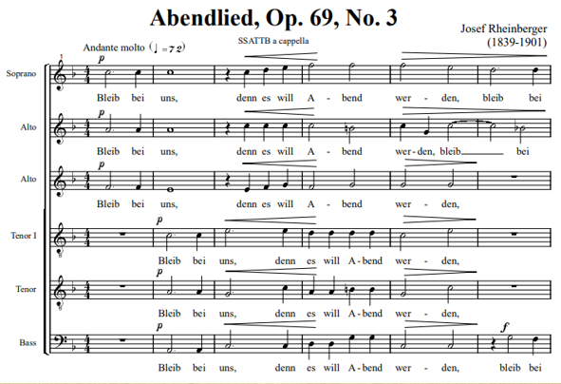
Prep practice in real music
Abendlied

Slide 14
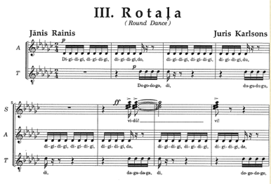
Rotala

Slide 15
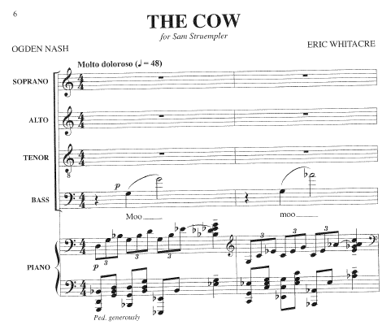
The Cow

Slide 16
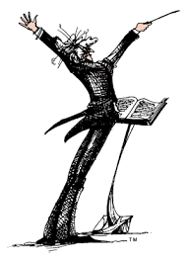
Final cuts
Should show…
  Exact stop point
  Character of stop
  Final consonant or vowel
Basic gesture…a circle
  Starts and ends in tempo
Bernstein…Mahler

Slide 17
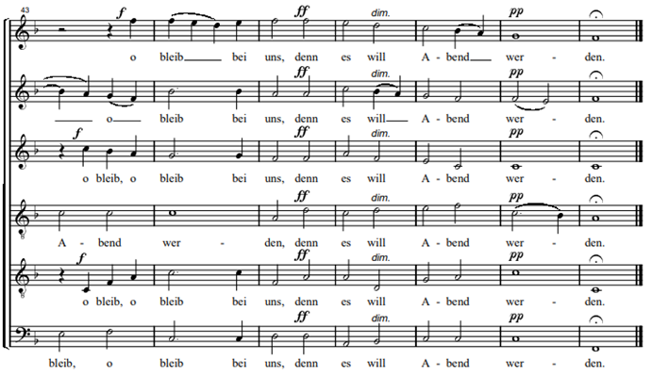
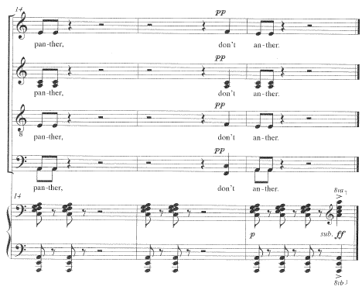
Examples
Abendlied
  Final ‘n’?
  If final ‘s’?
  If final ‘eh’?
The Panther
  ‘pp’ then subito ‘ff’
  Prepare ‘ff’ and show length

Slide 18




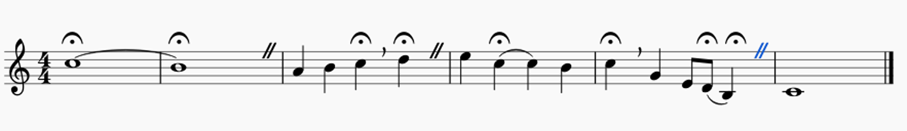
Fermatas
Three types
  Hold + full stop (caesura):
  Hold + No Breath and continue:
  Hold + cut-off and continue:
  (end of cut = start of prep)

Slide 19
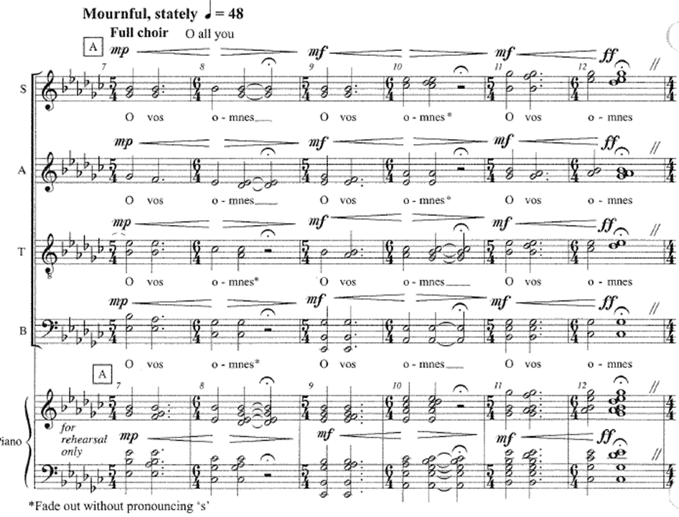
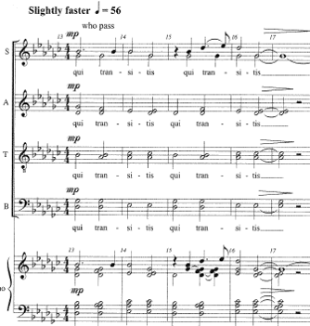
Fermata type I: Hold + full stop (caesura)
O Vos b.12-13: stop, pause, then breath

Slide 20
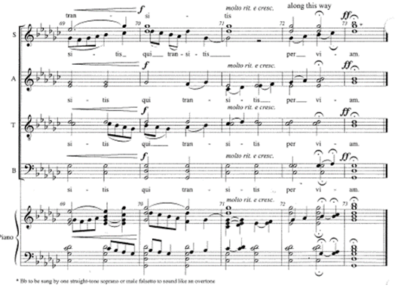

Fermata type II: hold but not break
O Vos 72-73: stop, move on without a break

Slide 21
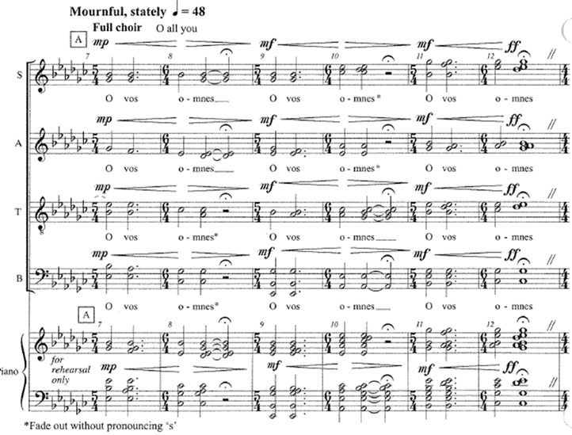
Fermata type III: hold + breath in tempo, no pause
O Vos b.8-9
  Cut followed by prep
  End of cut = start of prep

Slide 22

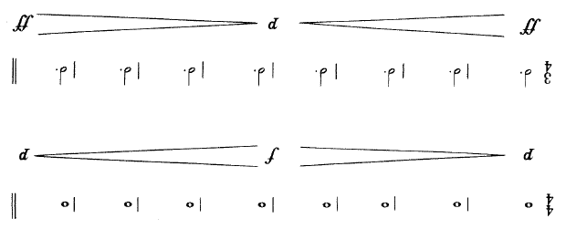
Dynamic change: gradual
How can we show dynamic change?
  Size of pattern
  Intensity of gesture
  Left-hand motion

Slide 23

Gradual change: O Vos 7-8
Try all three ways:
  Size change
  Intensity change
  L.H. gesture

Slide 24
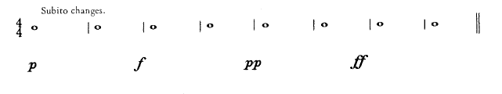

Dynamic change: sudden
When does the change occur?
  …on the down beat
When do we show the change
  …on the prep before the change
  ‘piano’ four ‘forte’ four

Slide 25
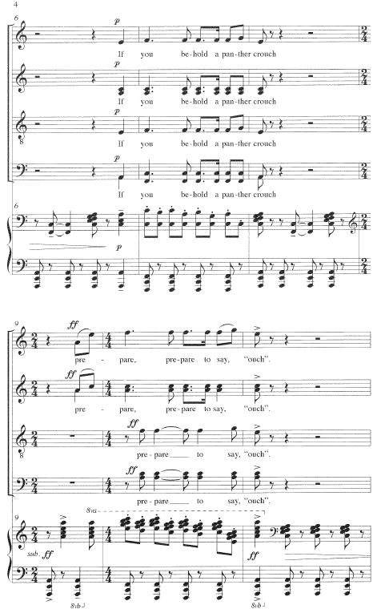
Sudden change P to FF: The Panther

Slide 26
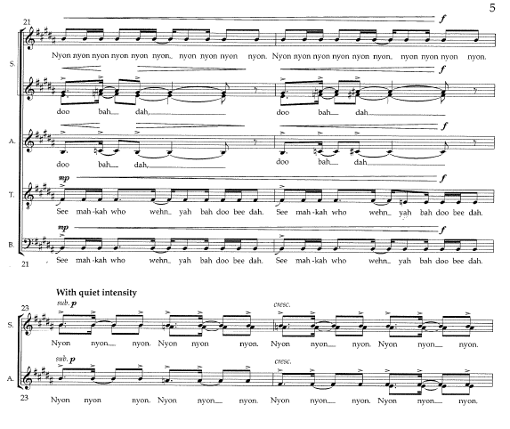

Sudden change F to P: Nyon
Big four
Small four

Slide 27
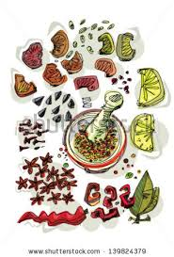

Articulations: spice in music
What are the basic types?
  Legato
  Staccato .
  Tenuto _
  Marcato
How to show?

Slide 28

Legato: Abendlied
Fluid
No bumps or sudden changes
Flexible wrist

Slide 29

Staccato: Rotala
Sharp flick of wrist
Light weight
Almost no time moving

Slide 30
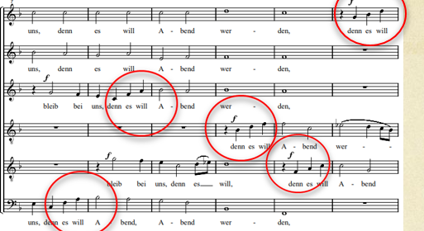
Tenuto: Abendlied
Heavy pull
Wrist leads…
  Fingers follow

Slide 31
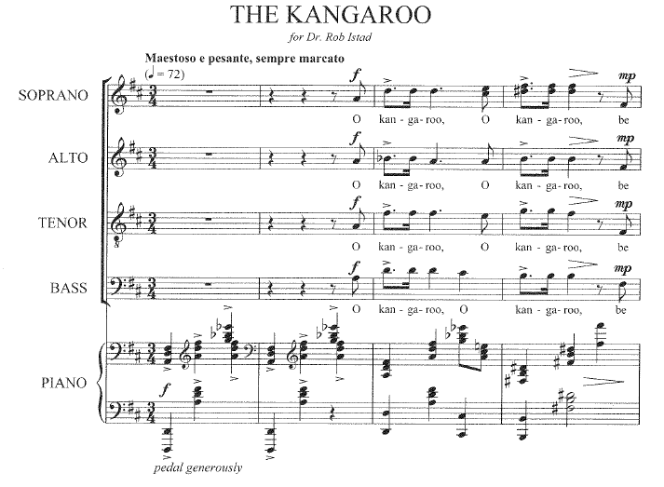
Marcato: the Kangaroo
Strong downward thrust
Short rebound
Intensity in hand

Slide 32
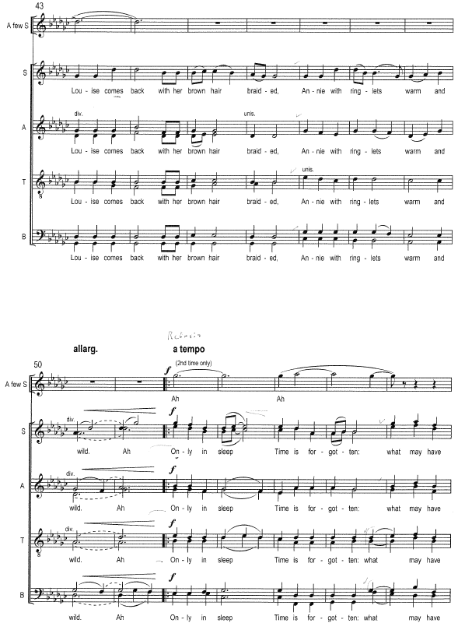
Tempo change: slowing down
How to show?
  More tenuto
  Eye contact

Slide 33
Tempo change: speeding up
More separation: staccato/marcato
Small pattern
Eye contact

Slide 34

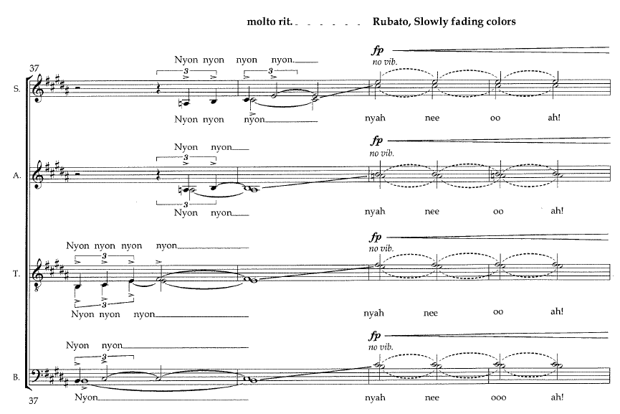
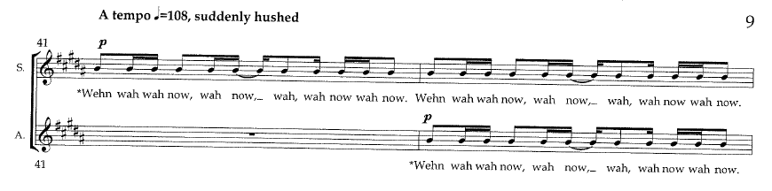
Tempo change: sudden
Change occurs on prep ictus
  New prep in new tempo

Slide 35
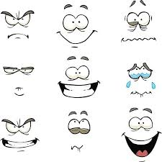


Facial expression
WE should decide what the piece means to us
  Shenandoah
    Lost love
    Homesickness
    Longing for something out of reach
  Nyon
    Youthful impetuousness
    Throwing off the shackles of convention
    Unbridled exuberance
This meaning should inform every aspect
  Musical decisions
  Facial expression

Slide 36
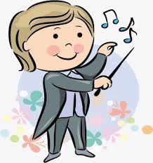

Bottom line!
Everything we do should contribute to better music!
  We are not time beaters
  We are full participants in the musical experience
What does the choir need from us right now, in this spot!!
  Usually… “less is more”
  Choose what the choir most needs right now and deliver
    Tempo
    Color
    Line
    Balancing
  First rehearsal might be entirely giving beats
  Concert might be NO patterns, just expressive nuance gestures

Slide 37

